Slide 1
GridLAB-D Tutorial 4
Part 1: Demand response
David P. Chassin
Summer 2016
dchassin@stanford.edu
All registered trademarks are hereby recognized.

Slide 2
Tutorial Overview
Demand Response
Background on Demand Response (DR)
Implementation of DR
Modeling of DR in GridLAB-D
Retail Markets
Tariff implementations
Real-time pricing by retail auctions
Database operations
MySQL databases

Slide 3
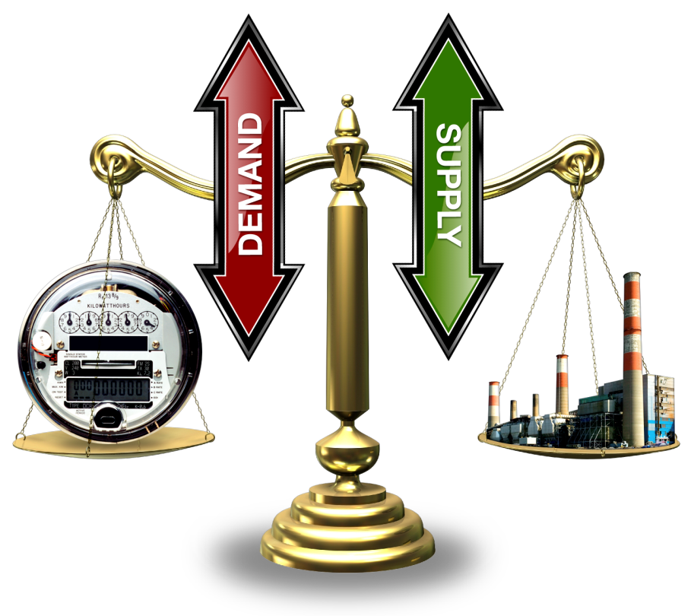
What is demand response (DR)?
Supply = Demand condition
Energy balance e.g., hourly wholesale markets
Power balance e.g., 5-minute redispatch control
Frequency control e.g., SCADA (area control)
Conventional approach
Supply follows demand
Smart grid approach
Load asked/allowed to participate

Slide 4
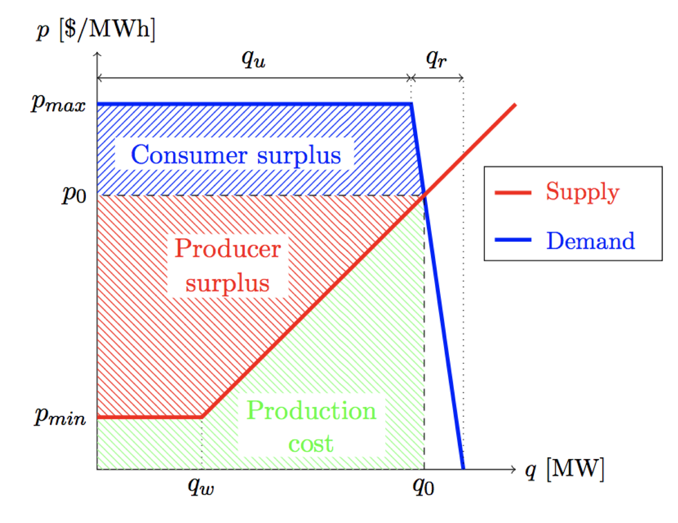
Demand response benefits
Active end-use loads
Participate in operations
Minimal consumer impact
Benefits to consumer
Savings opportunity
Support for renewables
Benefits to utility
Peak load reduction
Regulating services
Emergency operations

Slide 5
Dispatch of demand response
Effective demand response requires a control input
Direct load control uses a boolean signal
Indirect load control uses a continuous signal
Signals can be sent by utilities or DR aggregator
Prices and/or other dispatch signals
Optimal signals (e.g., lambda) are effectively prices
Markets can be used to “discover” prices
Mechanism design problem
Incentive compatibility
Duality gap

Slide 6
Market-based DR
Bids submitted by two primary resources
Supply – bid power they can provide at a given price
Demand – bid power they can forgo at a given price
Both bids are for a finite time interval
Market closes and clears
Bidding process is stopped
Supply and demand bids are sorted to two curves
Intersection of curves is the clearing price and quantity
Process repeated for every time interval

Slide 7
Price Elasticity of the End Use Loads
Demand
(elastic)
Price
Demand
Price ($/MW)
(inelastic)
Price
Supply
Quantity (MW)
Notes:
Changing today's inelastic demand to dynamically respond to the market is broadly recognized as the key to stabilizing prices … and allowing lead time to add capacity at lower risk.
The technology to create a much more elastic demand curve must move quickly into the market, and dynamic markets for supply and demand must be created on many levels and scales.

Slide 8
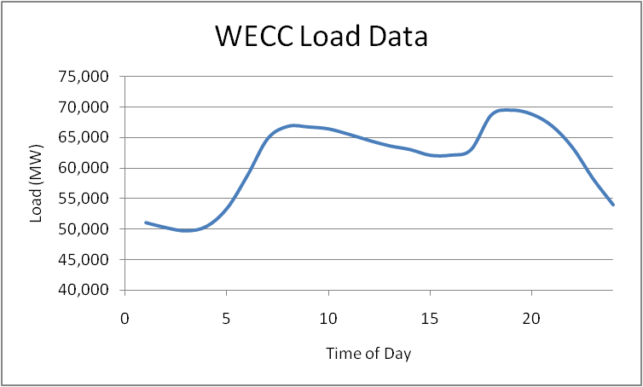
Impact of inelastic demand
Systems design to meet peak inelastic load
Requires more installed generation capacity
Causes more costly unit to be dispatched on peal

Slide 9
Utilization of Electricity Infrastructure
25% of distribution & 10% of generation assets
Asset value is 100s of billions of dollars used less than 400 h/y
Similar for transmission
Hourly Loads as Fraction of Peak, Sorted from Highest to Lowest
90%
generation
75%
5% = ~400 hrs/yr
distribution
5%
(8,760 hrs)
Notes:
Grid assets must be sized to meet peak demand, but their overall utilization over the course of the year is low.
These are load duration curves in which the loads for the year (hourly in this case) are sorted from highest to lowest.
When normalized to the peak load (100% load factor), they illustrate the utilization of an asset.
This plot shows the utilization of generation and a typical distribution feeder in the U.S.
Note that the average utilization (50-th percentile) for the year for generation is about 70%.
For distribution it is below 50%.
These do not include the reserve margins, which lower utilization of actual capacity substantially.
(CLICK) Note how much capacity is needed for only 5% of the hours of the year (438 hours):
(CLICK) 25% of our distribution capacity
(CLICK) and about 10% of our generation capacity exist only to serve loads for those few hours.
If we can displace those loads with demand response, distributed generation, and efficiency measures …
That would represent huge reductions in needed infrastructure.

Slide 10
Peak Load Reduction
Non-linear power system characteristics
Variable efficiencies
Higher losses under heavy loading
Peak generating units are typically less efficient
High peak load conditions are more costly
Reduces profit under most tariffs

Slide 11


Peak Load Reduction cont.
Line Losses
Generator Efficiencies
Typical power line
Quadratic losses
Heat Rate
British Thermal Units (Btu) to generate 1 kWh electric energy
Coal Steam: 10,818 Btu/kWh
Combined Cycle: 8,931 Btu/kWh
CT/Diesel: 11,667 Btu/kWh

Slide 12
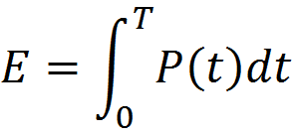
Optimal Peak Reduction
If generators "follow" load
Must meet peak loading
If the load is “flattened”
Same energy with less infrastructure
Stay at optimal efficiency
How?
Storage (expensive)
Flexible loads (too few)

Slide 13
Realistic Peak Reduction
Cannot completely flatten load
Focus highest peaks
Greatest benefits (non-linear)
Utility priorities
Efficiency programs (DSM)
Behavior changes (Tariffs)
Demand response

Slide 14
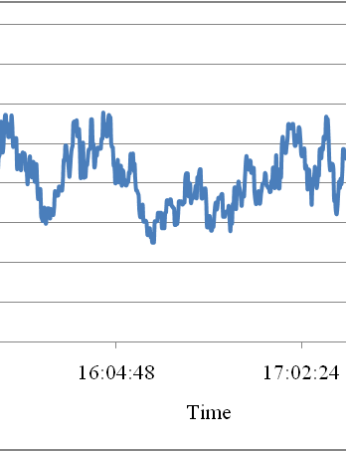
Load-base regulating services
Loads always fluctuate
Different frequency components
Diversity effects
System adjusts to follow load
Local voltage control
System frequency regulation
Demand can provide regulation
Frequency response (droop)
Voltage response

Slide 15

Emergency Conditions
Blackout are complex events
Involves millions of components
Heavy load often cited as contributing factor
No feedback to customer when load is endangering a system
Demand response can automate system protection

Slide 16
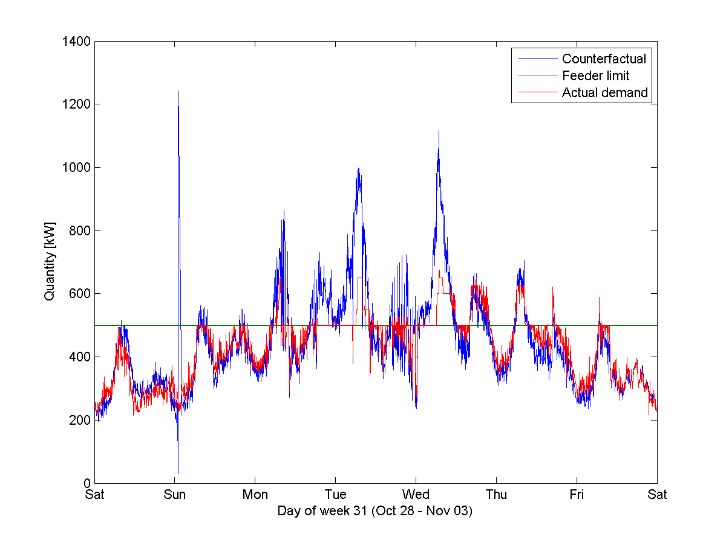
What are we trying to do?
Managing an Actual Distribution Constraint from
the Olympic Peninsula Demonstration
Unless DG or storage are present, there is no safe way to serve overload!
feeder capacity

Slide 17


How do we manage the response?
The key challenge for DR is managing the rebound!
Initially AC = 0 (~20 min)
Rises to ~80% of initial load (~1 hr), ~93% at steady-state
Cooldown load at full capacity (~1/2 hr) – “rebound” effect
Ongoing cooldown to 125% of initial load (~1 hr)

Slide 18
What can GridLAB-D do?
11.5% load reduction on peak day
Accomplished with complex system of rotating TOU prices

Slide 19
What are the effects to the customer?
TOU/CPP homes provide ~2F average increase
Duration of thermostat setup is 6 hours during peak
Unintended consequence: high CPP prices lowered comfort

Slide 20
Types of demand response
Direct load control
Load control remote control switch
Thermostat setback control
Indirect load control
Time Of Use (TOU)
Critical Peak Price (CPP)
Real Time Price (RTP)
Passive (single auction/no load bidding)
Double Auction (load bidding)
Distributed Control (Grid Friendly Appliances)

Slide 21
Direct Load Control
Utility has a direct control path to the appliance controller.
Customer compliance obtained through tariff or contract
Utility controls end use load according to tariff/contract.
Customer compensated for allowing this type of control
Additional compensated may be given for using the control
Utilities like “big red button” can push when needed
Know exactly how much load should respond
Caveats: free-riders, active load fraction, equipment failures

Slide 22
Time-of-use (TOU)
Implemented as a tariff or rate design
Voluntary (op-in, opt-out)
Mandatory (regulator-approved)
Two or more tiers
Off-peak (low price)
Shoulder (average price)
On-peak (high price)
On-peak to off-peak ratio must be significant
Low → increases customer costs → fewer customer signup

Slide 23
TOU schedules
schedule cooling_setback {
16-21 * * * * 1; // peak-time setback
22-15 * * * * 0; // off-peak setback
}
object house {
cooling_setpoint cooling_setback*2+72;
}

Slide 24
Critical Peak Pricing (CPP)
CPP can be implemented in 2 ways
Human response – e.g., phone call, email, text message
Difficult to model
More common approach
Hardware response – e.g., utility signal to appliances
Easy to model
Less common approach

Slide 25
CPP signals
class house {
double price_signal[$/MWh];
double price_sensitivity[degF*MWh/$];
}
object house {
price_sensitivity 0.1;
cooling_setpoint cooling_offset*comfort+72;
object player {
file “cpp.csv”;
target price_signal;
};
}

Slide 26
Demand Response Rebound
DR operates by adjusting power and/or energy demand
Thermostatic have internal closed loop on energy
DR relies on thermal mass to defer power demand
There is a limited resource
HVAC system can defer operation but must eventually turn on
Dryer can lower temperature, but energy to dry is fixed
Resource magnitude depends on technical/social constaints
With a TOU or CPP a rebound can be experienced

Slide 27
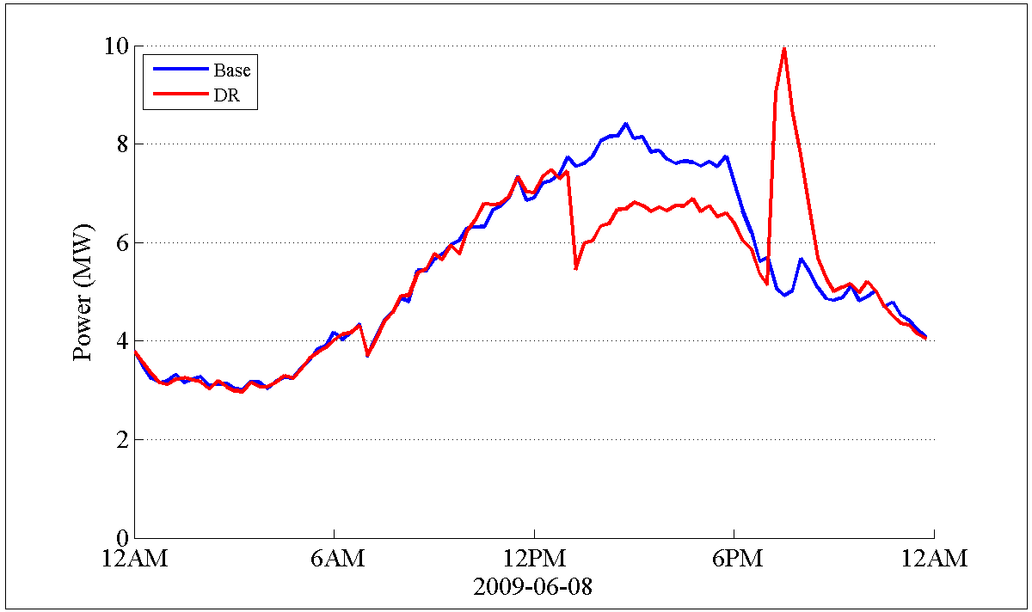
Demand response rebound

Slide 28
Real Time Price (RTP)
A real time price is similar to a TOU price with a hardware implementation except that the price can change every 5 minutes.
Because it changes so often it is necessary to implement this with hardware.
A RTP is a more accurate representation of the true cost of consuming electrical energy.

Slide 29
RTP prices
class house {
double price_signal[$/MWh];
double price_sensitivity[degF*MWh/$];
}
object house {
price_sensitivity 0.1;
cooling_setpoint cooling_offset*comfort+72;
object player {
file “rtp.csv”;
target price_signal;
};
}

Slide 30
GridLAB-D Tutorial 4
Part 2: Real-time pricing markets

Slide 31
Real time markets
RTP can include many different costs in a system
Wholesale power cost
Transmission level congestion cost
Distribution level congestion cost
Regulation cost
RTP signal can reveal true cost
Consumer avoids complexity of power system
Note: signal may not be actual price
Number which indicates relative cost at a given time

Slide 32
RTP-Double Auction Market
Price
Demand
(elastic)
Demand
Price ($/MW)
(inelastic)
Price, mitigated
Supply
Quantity (MW)
Notes:
Changing today's inelastic demand to dynamically respond to the market is broadly recognized as the key to stabilizing prices … and allowing lead time to add capacity at lower risk.
The technology to create a much more elastic demand curve must move quickly into the market, and dynamic markets for supply and demand must be created on many levels and scales.

Slide 33
RTP-Double Auction Market
A double auction can mitigate rebound
A true double auction can address many issues
Combined bids from loads, distributed generation and storage
Issues when market is “cleared”
Equitable solutions (differences between feeder)
Double auction requires bids from participants
More upstream than simple RTP system

Slide 34
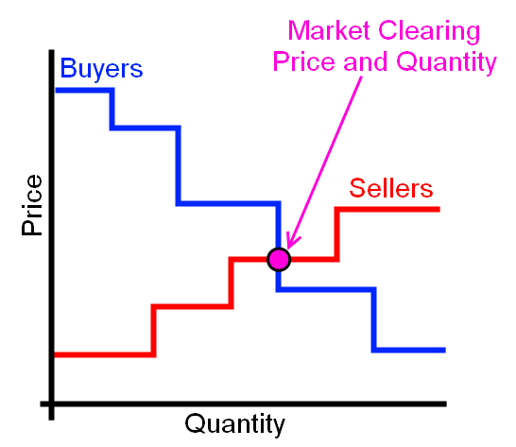
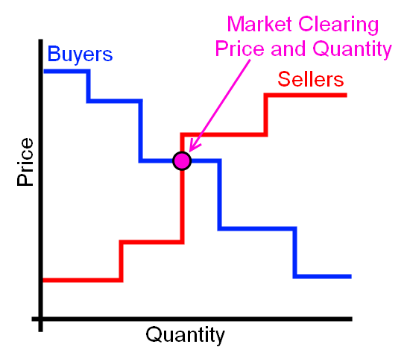
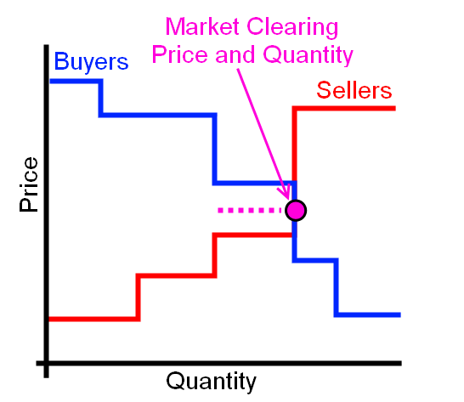
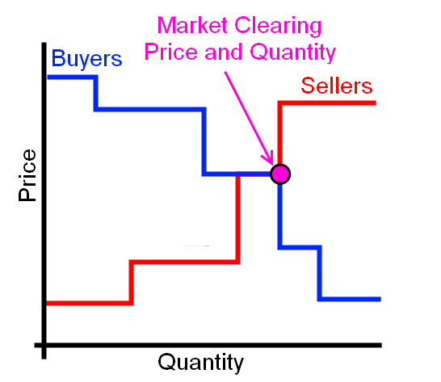
Market Clearing

Slide 35
Market Objects
Controller
Auction
Passive Controller
Stub Auction
Note: Passive controller can be used with an auction, or a number of other objects.
Used to create a two-way, transactive bidding market.
Used for delivering prices to a purely reactive controller.

Slide 36
Auction and Controller Objects
Auction Objects
Controller Objects
One auction per feeder
Auction collects bids
Clears the market periodically
Delivers cleared prices
Controller objects read prices
Wholesale price
Player inputs LMP
Players for TOU/CPP/RTP
Controller for each bidding object, e.g.,
HVAC Thermostat
Hot water heater
EV charger
Bid reveals price at which load state will change
Bid include power

Slide 37
Stubauction Object
object stubauction {
name Market_1;
period 300;
object player {
file Price.player;
property current_market.clearing_price;
};
object recorder {
property avg24,std24;
limit 2880;
interval 60;
file price_statistics.csv;
};
}
The auction is responsible for determining the clearing price.
In a stub-auction there is no clearing of the market, the clearing price is input through a .player file.

Slide 38
Passive Controller – HVAC
k
k
Price*
P_{avg}
P_{clear}
T_{min}
T_{set}
T_{desired}
T_{current}
T_{max}
Temperature

Slide 39
Passive Controller - HVAC
The passive controller does not send a bid signal to the market.
This implies unidirectional communications.
This controller is set for a 24 hour moving window for market values.
The moving window can be changed to any value.
Ramp and Range values set the “responsiveness” of the passive controller.
object passive_controller {
base_setpoint cooling3*1;
control_mode RAMP;
sensitivity 1;
expectation_obj Market_1;
expectation_prop avg24;
setpoint_prop cooling_setpoint;
state_prop override;
observation_obj Market_1;
observation_prop current_market.clearing_price;
mean_observation_prop avg24;
stdev_observation_prop std24;
range_low -1.500;
range_high 2.500;
ramp_low 1.333;
ramp_high 0.800;
}

Slide 40
Price Player
2000-01-01 00:00:00,0.065139609
+1h,0.063279907
+1h,0.047926635
+1h,0.054980748
+1h,0.054144897
+1h,0.052692165
+1h,0.025675894
+1h,0.048756545
+1h,0.060731834
+1h,0.067444366
+1h,0.077139106
+1h,0.115129386
+1h,0.314471806
+1h,0.103280668
+1h,0.107517265
+1h,0.090978092
+1h,0.099465131
+1h,0.163445608
+1h,0.188779549
+1h,0.122554232
+1h,0.281734869
+1h,0.240559158
+1h,0.082833806
+1h,0.081005661
+1h,0.062340608
+1h,0.058395271
The price.player file reads a price into the auction object.
This price is used to represent the cleared price of power for a TOU or RTP market structure.
The example shows price in 1 hour time steps, but smaller or larger time steps can be used.
A price signal is then sent to every control and based on this signal and the controller values.
The load will then respond accordingly.

Slide 41
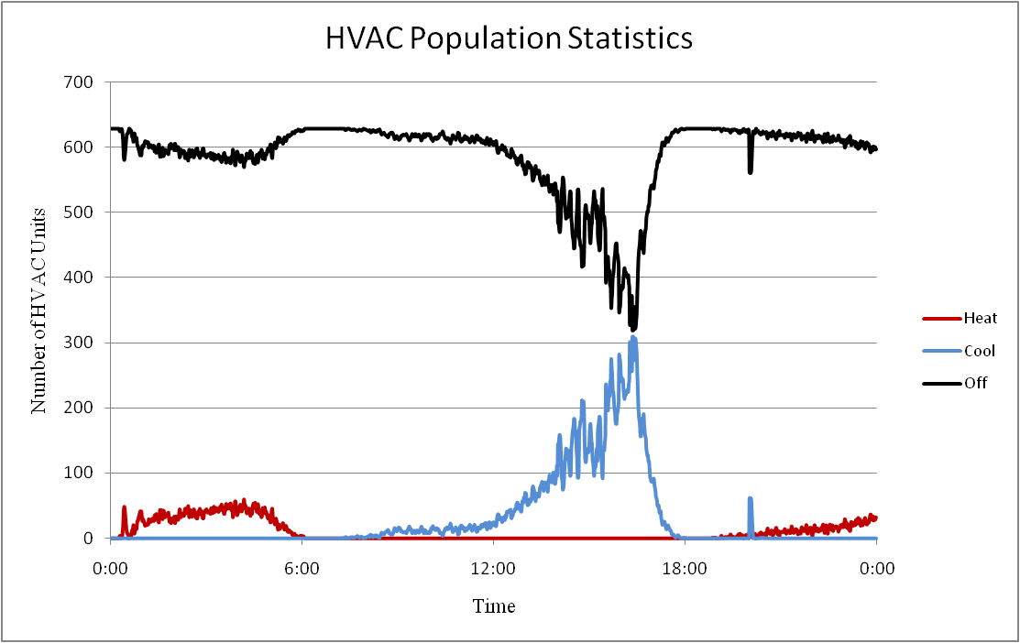
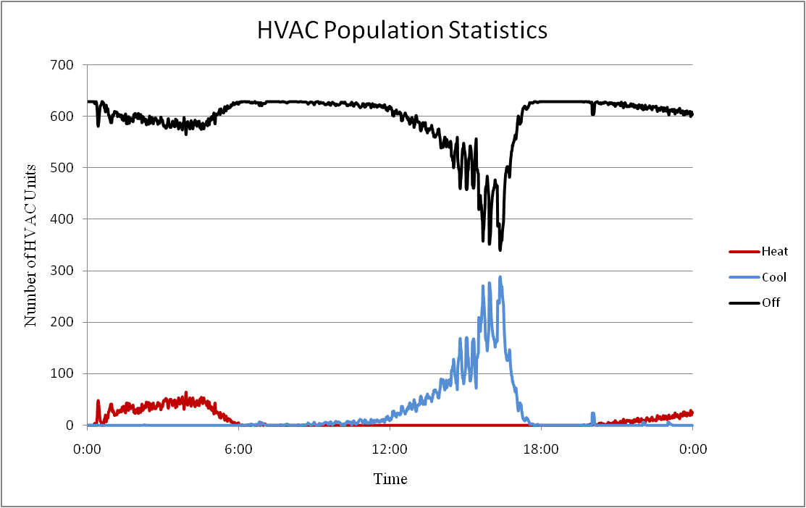
Population Statistics
HVAC units in one of 4 modes.
Off
Cooling
Heating
Heating (AUX)
Control signals distort population statistics.
Multi-state physical models
Simulates how the control signal affect population
Changes power consumption

Slide 42
DLC in GridLAB-D
HVACs - Cycling
Water Heaters - Probabilistic
object passive_controller {
control_mode DIRECT_LOAD_CONTROL;
dlc_mode CYCLING;
cycle_length_on 803;
cycle_length_off 917;
state_property override;
observation_object Market_1;
observation_property past_market.clearing_price;
second_tier_price 0.680986;
};
object passive_controller {
period 900;
control_mode PROBABILITY_OFF;
distribution_type NORMAL;
observation_object Market_1;
observation_property past_market.clearing_price;
stdev_observation_property my_std;
expectation_object Market_1;
expectation_property my_avg;
comfort_level 9999.00;
state_property override;
};
Pool Pumps - Off
object passive_controller {
control_mode DIRECT_LOAD_CONTROL;
dlc_mode OFF;
state_property override;
observation_object Market_1;
observation_property past_market.clearing_price;
second_tier_price 0.680986;
};

Slide 43
Price Elasticity
Represent change in load from change in price
Used for loads that don’t automate DR controls (e.g. dryers).
Based on PRISM1 models.
Empirically based – data needed from DR studies
¹A. Faruqui and L. Wood, “Quantifying the Benefits of Dynamic Pricing in the Mass Market”, The Brattle Group, Prepared for Edison Electric Institute, January 2008.

Slide 44
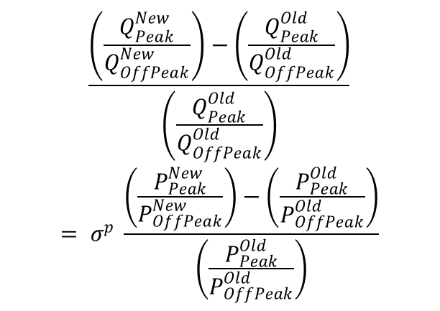
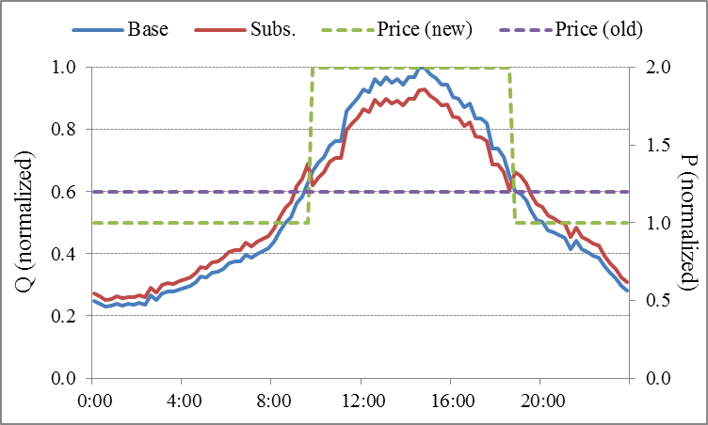
Price Elasticity Model
Substitution Elasticity
Customer’s willingness to shift their energy usage from on-peak to off-peak time periods (deferred energy usage).

Slide 45
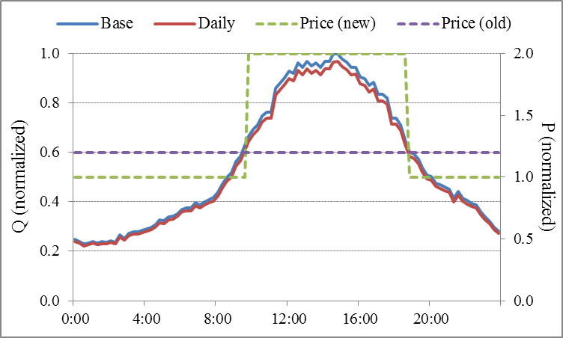
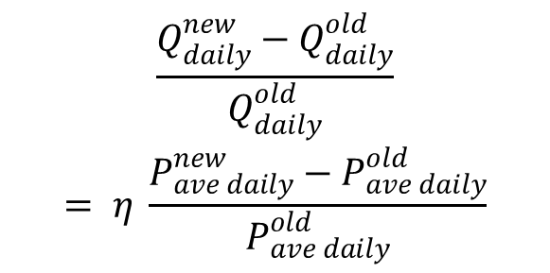
Price Elasticity Model (cont.)
Daily Elasticity
Customer’s willingness to decrease (or increase) daily energy consumption in response to a change in price.

Slide 46
Elasticity in GridLAB-D
object passive_controller {
period 900;
control_mode ELASTICITY_MODEL;
two_tier_cpp true;
observation_object Market_1;
observation_property past_market.clearing_price;
state_property multiplier;
linearize_elasticity true;
critical_day CPP_days_R1.value;
first_tier_hours 12;
second_tier_hours 12;
third_tier_hours 6;
first_tier_price 0.069987;
second_tier_price 0.139973;
third_tier_price 0.699867;
old_first_tier_price 0.124300;
old_second_tier_price 0.124300;
old_third_tier_price 0.124300;
daily_elasticity -0.1305;
sub_elasticity_first_second -0.0198;
sub_elasticity_first_third -0.0290;
}
The passive controller does not send a bid signal to the market, as it is representing human behavior (child of a ZIPload).
Can represent either 2-rate or 3-rate plus CPP.
Each rate period has it’s own elasticity in comparison to lowest rate period.
Negative elasticity represents less energy consumption (daily) and less energy consumed during critical period (substitution).
Updates percent load change every market period.

Slide 47
Auction Objects
object auction { string name; string unit; //i.e. MW, kW, or kWh integer period[s]; // Interval between market clearings
integer latency[s]; // Lag between clearing and delivery
string special_mode; // Allows for buyer or seller only
double pricecap; // Maximum bid price allowed
boolean verbose; // Allows user to watch bidding
double init_price; // Used to “bootstrap” market if warmup=TRUE
double init_stdev;
object capacity_reference_object; // more details following
integer warmup; // 1=TRUE, 0=FALSE
}
Defines market intervals
Provides clearing price and quantity after clearing, average prices, and standard deviation
Allows for active bidding from buyers and sellers
Also available – previous and current market clearing statistics such as marginal quantity, marginal load, etc.

Slide 48
Auction Objects
The statistical interval desired must be created by the user in the following form:
class auction {
double yyyy_price_mean_xx;
double yyyy_price_stdev_xx;
}
Where “yyyy” can be “current” or “past” and “xx” can be “#m”, “#h”, “#d”, or “#w”:
class auction {
double past_price_mean_5d;
double current_price_stdev_3m;
}
Any number of statistics can be created and used by various objects

Slide 49
Auction Objects
Available auction outputs:
user specified statistics
current_market.clearing_price
current_market.clearing_quantity
past_market.clearing_price
past_market.clearing_quantity
clearing case type

Slide 50
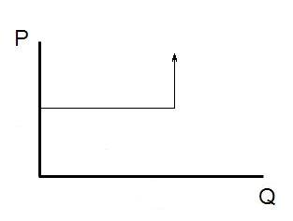
Capacity Object
Acts as a supply agent
limits power flowing through object (or other properties)
If below capacity, market should clear at bid price
If at/above capacity, should clear to limit quantity
to pricecap
Seller bid is a user-defined quantity and typically an RTP price signal
Buyer bid is the estimate of the unresponsive load as the quantity and price cap
Seller bid
Load bid
Unresponsive load
Responsive or bidding load

Slide 51
Example Capacity Object
object auction {
name Market_1;
type DOUBLE;
unit kW;
period 300;
// Initial statistics to stabilize initial market
init_price 35.0001;
init_stdev 10;
warmup 1;
// looking at the feeder regulator and power flowing through
capacity_reference_object 1406_regulator;
capacity_reference_property power_out_real;
capacity_reference_bid_price seller1*1;
max_capacity_reference_bid_quantity 125; //kW
}

Slide 52
Bidding Function
When auction is established objects can submit bids
submit_bid function structure
Market to bid into
Object that is bidding
Quantity to bid
Price of bid

Slide 53
Clearing of the Market
Previous values stored in past_market.clearing_price and past_market.clearing_quantity
Current cleared values stored in current_market.clearing_price and current_market.clearing_quantity
Output values can be read by recorder - or – directly delivered to a controller object

Slide 54
Controller Objects
Provides an interaction point between loads and market.
Uses various external inputs to determine a bid_quantity and bid_price for the object it is attached to.
class controller { enumeration control_mode; // RAMP or DOUBLE_RAMP
string market; // Name of auction object to be used string parent; // Object modified by controller
string setpoint; // Set point to be modified by controller
string base_setpoint; // Desired set point value
string target; // Value set point is compared against integer period[s];
string demand; // Bid quantity of object
boolean verbose;
string bid_mode;
string simple_mode; // Various “easy” connections to appliances
property average_target;
property standard_deviation_target;
…
}

Slide 55
Controller Objects - Ramp
object controller { …
control_mode RAMP;
double range_low;
double range_high;
double ramp_low;
double ramp_high;
double slider_setting_heat; //Simple pre-set slider 0-100%
double slider_setting_cool; //participation in market (DOUBLE_RAMP)
double slider_setting; //(RAMP) – sets ranges and ramps
}
Control mode dependent on object being controlled
Determines how object bids and responds to price
RAMP and DOUBLE_RAMP modes control thermostatic set points

Slide 56
Controller Objects - Ramp

Slide 57
Controller Objects – Double Ramp
Normal action could cause conflicting pre-cooling and pre-heating states
DOUBLE_RAMP provides two means for resolving this conflict (deadband and sliding)

Slide 58
Controller Objects – Double Ramp
deadband resolution essentially limits the range of the pre-cooling and pre-heating and determines an average amount.
sliding resolution determines which mode (heat or cool) was last used, and allows this to override the other.

Slide 59
Controller Objects
object passive_controller { string control_mode; //RAMP, PROBABILITY_OFF, others TBD
string mean_observation_property;
string stdev_observation_property;
string expectation_object;
string expectation_property;
string observation_object;
string observation_property; string parent;
string setpoint;
string base_setpoint;
string setpoint_property;
string state_property; integer period[s];
enum distribution_type; //NORMAL, UNIFORM, EXPONENTIAL (PROB_OFF)
double comfort_level; //0-inf (PROB_OFF)
double range_low/high, ramp_low/high; //(RAMP)
}
Responds to a signal (not just price), but does not bid into market.

Slide 60
Example controllers
object controller {
market Market_1;
bid_mode ON;
control_mode RAMP;
slider_setting 0.500;
base_setpoint cooling7*1;
period 300;
average_target current_price_mean_24h;
standard_deviation_target current_price_stdev_24h;
target air_temperature;
setpoint cooling_setpoint;
demand last_cooling_load;
total hvac_load;
load hvac_load;
state power_state;
range_high 5;
range_low -3;
};
object controller {
market Market_1;
bid_mode ON;
control_mode DOUBLE_RAMP;
resolve_mode DEADBAND;
slider_setting_heat 0.500;
slider_setting_cool 0.500;
heating_base_setpoint 68;
cooling_base_setpoint 74;
period 300;
average_target current_price_mean_24h;
standard_deviation_target current_price_stdev_24h;
target air_temperature;
heating_setpoint heating_setpoint;
heating_demand last_heating_load;
cooling_setpoint cooling_setpoint;
cooling_demand last_cooling_load;
deadband thermostat_deadband;
total hvac_load;
load hvac_load;
state power_state;
};
object passive_controller {
period 300;
control_mode PROBABILITY_OFF;
distribution_type NORMAL;
observation_object Market_1;
observation_property current_market.clearing_price;
stdev_observation_property current_price_stdev_24h;
expectation_object Market_1;
expectation_property current_price_mean_24h;
comfort_level 1.00;
state_property override;
};

Slide 61
Customer Billing
Use triplex_meter (customer meter)
Three billing types: UNIFORM, TIERED, HOURLY (RTP)
Includes a monthly fee and bill processing day
bill_dump allows you to collect all bills in a single file
object triplex_meter {
bill_mode UNIFORM;
price 0.1; // $/kWh
bill_day 1;
monthly_fee 10; //$
}
object triplex_meter {
bill_mode HOURLY;
// name of the auction
power_market my_market;
bill_day 1;
monthly_fee 10;
}
object triplex_meter {
bill_mode TIERED;
price 0.1;
bill_day 1;
monthly_fee 10;
first_tier_energy 100;
first_tier_price 0.15;
second_tier_energy 500;
second_tier_price 0.18;
third_tier_energy 1000;
third_tier_price 0.20;
}
object bill_dump {
runtime ‘2000-01-01 00:00:00’;
filename my_bill_dump.csv;
}

Slide 62
GridLAB-D Tutorial 4
Database operations

Slide 63
Module globals
Implements same functionality as tape module
Global variables for mysql module:
module mysql {
hostname "localhost";
username "gridlabd";
password "";
schema "gridlabd";
port 3306;
socketname "/tmp/mysql.sock";
}

Slide 64
Database object
Used by other objects to make queries
Specify server access/protocol
Specify default behaviors and options
Multiple database objects allowed
If multiple used, each object must specify database to use
Options:
NOCREATE: disables automatic table creation
NEWDB: destroys old schema before starting simulation
OVERWRITE: destroys old data before writing new data

Slide 65
Database object properties
object database {
hostname "localhost";
username "gridlabd";
password "";
schema "gridlabd";
port 3306;
socketname "/tmp/mysql.sock";
options SHOWQUERY|NOCREATE|NEWDB|OVERWRITE;
on_init file-name;
on_sync file-name;
on_term file-name;
sync_interval seconds;
tz_offset seconds;
uses_dst FALSE;
}

Slide 66
Players
object player {
property property-name;
table source-table;
connection database-object-name;
loop number-of-loops;
}
Syntax compatible with tape:player
“file” ⬅➔ “table”
“mode” and “filetype” are ignored

Slide 67
Recorders
Target object is parent (if specified)
If absent, all properties my use specify object name
Table name (aka, “file”)
Multiple objects can use same table (must have same fields)
Property list
Multiple fields allowed (comma separated)
Object name allowed (e.g., “name.property”)
Special fields
Record id, default is “id”
Timestamp, default “t”
Header fields (name, class, latitude, longitude), default is “”

Slide 68
Collectors
object collector {
property property-name;
group group-spec;
table|file source-table;
mode {"w","w+","a","a+"};
limit max-rows;
interval seconds;
connection database-object-name;
options PURGE;
}

Slide 69
MySQL Workbench

Slide 70
Exercises

Slide 71
Exercises
Run the CVR 13 Node system for 7 days with a constant price signal.
Plot the Regulator apparent power consumption, voltage at the regulator control node, price signals, and the HVAC system population statistics.
What is the peak load and how many HVAC units are in operation at this time?

Slide 72
Exercises
Run the CVR 13 Node system for 7 days with the default price signal.
Plot the Regulator apparent power consumption, voltage at the regulator control node, price signals, and the HVAC system population statistics.
How does the system operate with the price signal compare to without?

Slide 73
Exercises
Develop a control signal, i.e. price signal, that you think optimally controls the system. Explain your basis for this control signal.
Run the CVR 13 Node system for 7 days with the custom price signal.
Plot the Regulator apparent power consumption, voltage at the regulator control node, and the HVAC system population statistics.
How does this signal perform.
What is your opinion of a passive control signal?

Slide 74
Exercises
Using the IEEE 4-node, replace the load with a single home (don’t forget the transformer) with a double ramp HVAC controller.
Create an auction object using 24 hour statistics in BUYER_ONLY mode.
Observe the difference in demand when using different slider settings.
Add a water heater and a passive controller in probabilistic off mode. Observe the effect of the comfort level on demand.
Add billing to the customer meter and try the various billing types. Observe the differences in bills.
Observe the IEEE-13 node test system with markets.

